Slide 1
Mobile Musical Moments
Project Manager: Scott Thompson
Development Team: Joshua Brungar, Quentin Griffiths, Stephen Nancekivell, Simon Wadsworth

Slide 2


Slide 3
The Vision
To provide a software package that will allow a customer to record a currently playing song, and have it return the name and artist of the song.

Slide 4
Licensing
Our software package uses some closed source code – Entropy Fingerprinting Algortihm

Slide 5
Audio Recording
No premade features in the .NET Compact Framework for dealing with WAV files
To overcome this our own classes needed to be written
[How the recording works]

Slide 6
Interface
Buttons and Controls
Splash Screen
Outflow Layout

Slide 7
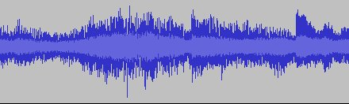
How we fingerprint audio.
More more less more less

Slide 8



Fingerprint Robustness.

Slide 9
The Backend
The backend essentially consists of a server that accepts simple queries from the device and returns an answer
It’s written as a threaded C# TCP Network application
It’s all string based

Slide 10
The Backend Server
When a incoming connection is received it challenges with client with a code as a means to provide some small amount of security
The client must provide the correct response code otherwise the server will simply close the connection

Slide 11
The Backend Server – Concurrency Problem
To allow for concurrent connections the server is written using Threads

Slide 12
The Backend Server
When a new connection is received it spawns another thread.
These threads do not need to communicate with each other

Slide 13
The Backend Server
After a connection is received and challenged, the server will wait for the client to send it a fingerprint.
From here it will then do a fingerprint comparison.
It will build an internal list of the songs that have matches

Slide 14
The Backend Server
After building the list, it needs to be transmitted via the network
For this to occur the list is transformed into XML

Slide 15
The Backend Server
When the list is received by the client it is put back together into an object.
The client can then use the list

